Slide 1
Intro to Neural Nets
RNNs for Text

Slide 2

Today’s Agenda
Background on NLP
Use Cases
Quick review on bag of words approaches, etc.
TextVectorization Layer
This implements basic standardization and punctuation removal. It assumes 1-grams, then one-hot encodes.
No stemming or stop word removal, by default.
Sequence vs. Bag-of-Words
Conceptually
Architectures for Sequences
Bidirectional LSTM

Slide 3
Quick Review of NLP Concepts
Pre-processing Text
Lower-casing, stop word removal, stemming, removing punctuation, stripping rare tokens, etc.
Tokenization (this may be chars, words, sentences, etc.
Integer encoding / indexing the tokens.
Finally, I may or may not leverage sequence information.
Q: what is a bag of words approach? What are n-grams?
 | Database | SQL | Index | Regression | Likelihood | linear
D1 | 24 | 21 | 9 | 0 | 0 | 3
D2 | 32 | 10 | 5 | 0 | 3 | 0
D3 | 12 | 16 | 5 | 0 | 0 | 0
D4 | 6 | 7 | 2 | 0 | 0 | 0
D5 | 43 | 31 | 20 | 0 | 3 | 0
D6 | 2 | 0 | 0 | 18 | 7 | 6
D7 | 0 | 0 | 1 | 32 | 12 | 0
D8 | 3 | 0 | 0 | 22 | 4 | 4
D9 | 1 | 0 | 0 | 34 | 27 | 25

Slide 4
Weighting Term-Documents: TF-IDF
Not all phrases are of equal importance…
E.g., David less important than Beckham
If a term occurs all the time, observing its presence is less informative
Inverse-document frequency (IDF) helps address this.
Term ‘weighting’ is then calculated as Term Frequency (TF) x IDF
n_{j}= # of docs containing the term, N = total # of docs
A term is deemed important if it has a high TF and/or a high IDF.
As TF goes up, the word is more common generally. As IDF goes up, it means very few documents contain this term.

Slide 5
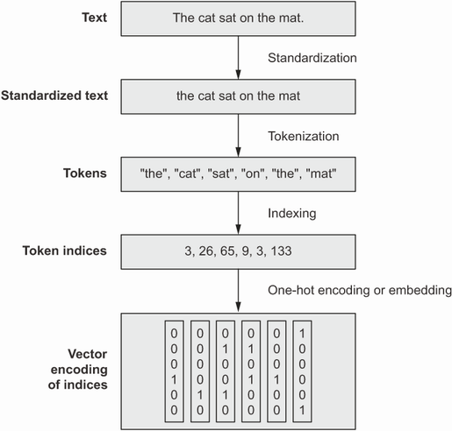
TextVectorization Layer
Pre-processing Text
Standardization, tokenization (words), one-hot-encoding / vectorization.
The Keras TextVectorization() layer achieves these steps quickly.
Customization
You can work with n-grams, and do other sorts of pre-processing, using arguments.
Options
Include as part of TF Dataset pipeline (more efficient)
Include as a layer in your Keras model.
Notes:
All text vectorization techniques generally work the same way.
We throw out words we don’t want, standardize the rest.
We then tokenize the text (split into lists of characters, words, or word-groups.
We then convert each token into some numeric vector representation (many ways we might do this).

Slide 6
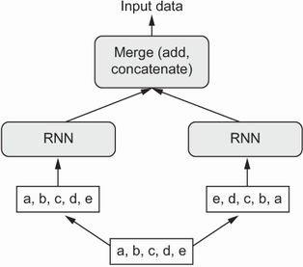
Bidirectional LSTM
We Saw This Last Time
Take each sequence as input data, as well as a flipped/reversed copy.
Was state of the art for text processing until relatively recently (transformers now dominate).
Instead of Time Series We Pass…
Sequences of one-hot-encodings of terms.
Sequences of pre-trained vector embeddings of terms.

Slide 7
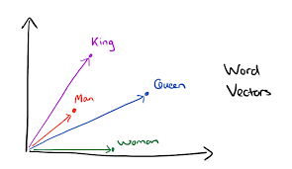
Embedding Layer
With Hot Encodings, Model Will Still Struggle to Figure Out Semantics
Despite having sequence, the model is “told” that the tokens are orthogonal / independent of one another in their meanings. But that’s not true!
Textual Embedding Layer First Provides Dimensionality Reduction
Represent words into a lower dimensional space – similar vector = similar meaning.
The Embedding layer is a lookup table that maps tokens to vectors. For each token in the vocabulary, the network learns a vector representation. The vectors are initially random, and the network updates them in training to learn representations that help in prediction (just like with convolution filters!).
In practice, it is learning semantic relationships…
This is much better for an RNN than a hot encoding, because 120 values (for example) is << 20,000!
Notes:
Available pre-trained embedding layers (e.g., trained on Wikipedia page data), but you can also fit these models on your own corpus of text, to learn context-specific embeddings.

Slide 8
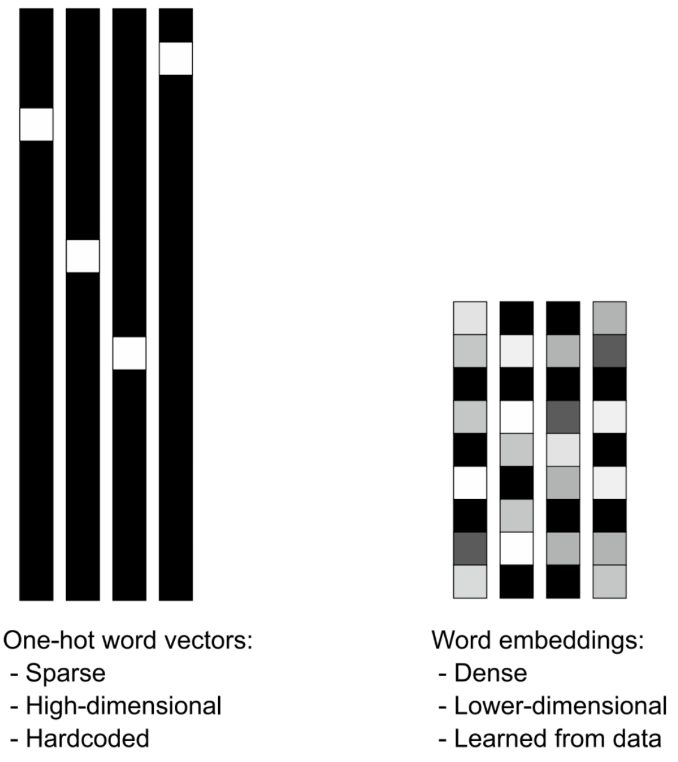
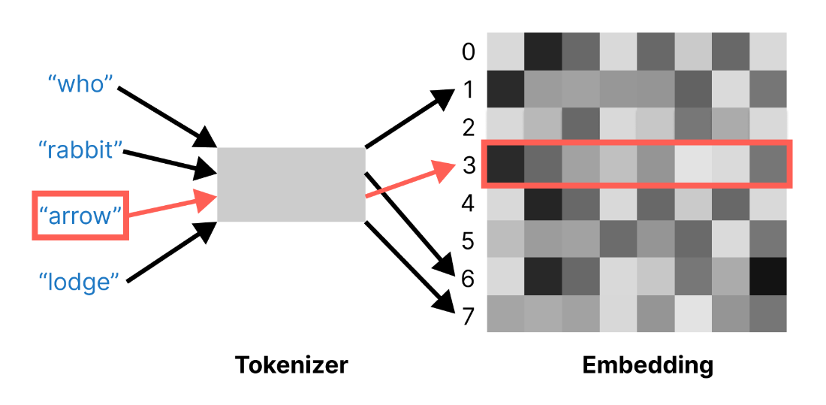
Numeric (Vector) Representations of Text
Notes:
Available pre-trained embedding layers (e.g., trained on Wikipedia page data), but you can also fit these models on your own corpus of text, to learn context-specific embeddings.

Slide 9
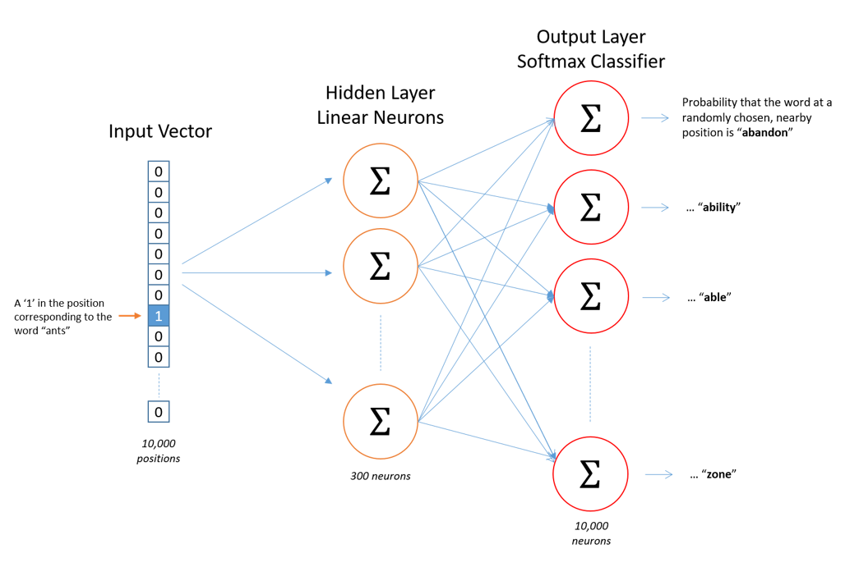
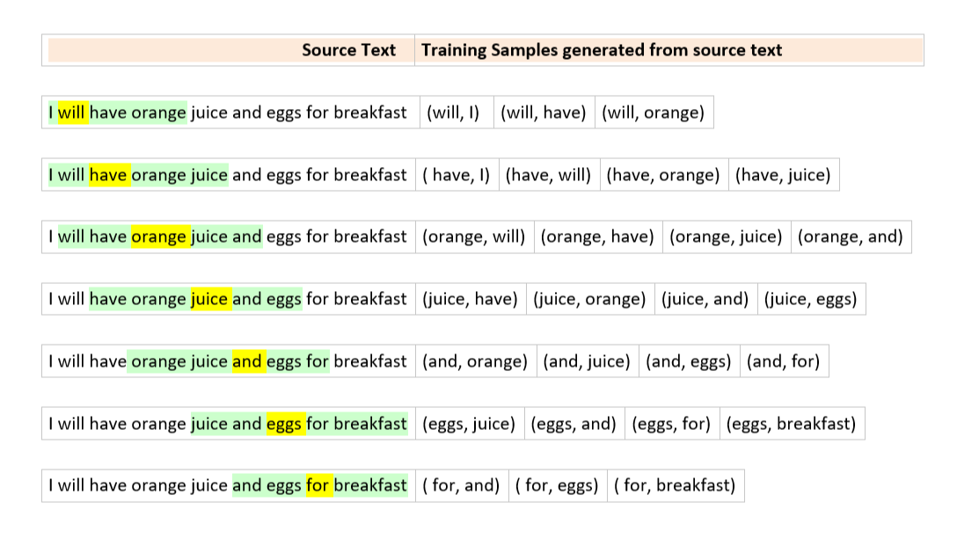
Pre-Trained Embeddings: Word2Vec
Word2Vec
Two types: CBoW and Skipgram
Construct training examples and labels.
Notes:
This is skipgram on the right. One word to surrounding context words (we map input word to

Slide 10
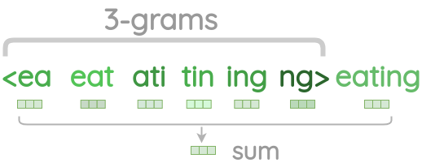
Pre-Trained Embeddings: Limitation
Out of Sample Words
Both GloVe and Word2Vec are limited to words you’ve seen before in training. They cannot handle new words. Those words thus get omitted / dropped, or you need to do something different.
FastText
An extension to Word2Vec which learns character n-grams of words. So, instead of embedding words, we embed portions of words (e.g., a 3-gram character representation would break up the word ‘coffee’ into ‘cof’, ‘off’, ‘ffe’, … and then learn vector embeddings of each.
Notes:
This is skipgram on the right. One word to surrounding context words (we map input word to

Slide 11
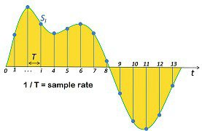
RNN for Audio
Same Sequence Concepts Work for Audio Data
Audio files are just sequences of numeric values (amplitude), possibly two if it was recorded in stereo.
Once we recognize this, we realize we can predict things about audio sequences too!
Notes:
This is skipgram on the right. One word to surrounding context words (we map input word to

Slide 12
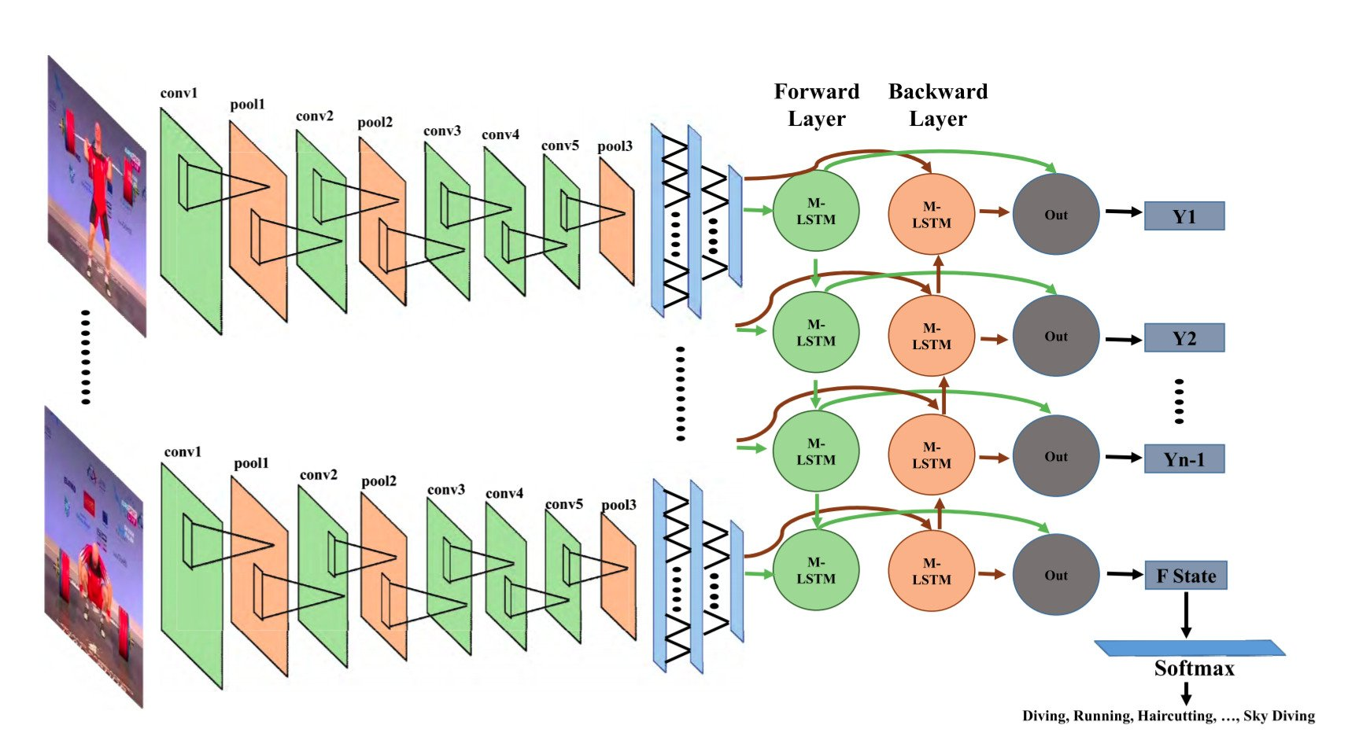
CNN-RNN for Video
Hybrid Topology for Image Sequences
We Use CNN’s to detect features at a given input.
We feed those feature maps into an RNN architecture, like LSTM.
We can use this topology to predict things about videos.
You might pre-process frames using a pre-trained CNN and pass feature maps as sequences to an RNN.
Notes:
This is skipgram on the right. One word to surrounding context words (we map input word to

Slide 13
Questions?

